Slide 1
Does the weight of a substance change after a chemical reaction?
Mr. E
4th Grade Science

Slide 2
I will test to see if the weight of my substances change after a chemical reaction occurs. I will test different substances that cause a chemical reaction when mixed. I will test to see if the weight changes of baking soda, lemon juice and water after they are mixed with another substance.
Does the weight of a substance change after a chemical reaction?

Slide 3
I believe that chemical reactions will not change the weight of the substances.

Slide 4
Place a cup with baking soda and a cup with vinegar upright inside a bag and be sure to not spill them.
Completely seal the bag and place the entire bag onto the pan of the triple beam balance. Make sure no part of the bag is hanging off the edge of the pan. Weigh the bag and record the weight.
Spill the contents of the cups inside the bag without opening it.
Record observations.
Weigh the bag and its contents, again making sure that no part of the bag is hanging off the edge of the pan.
Set the bag aside and repeat this process with the following mixtures: baking soda and lemon juice; and Alka-Seltzer and water.

Slide 5
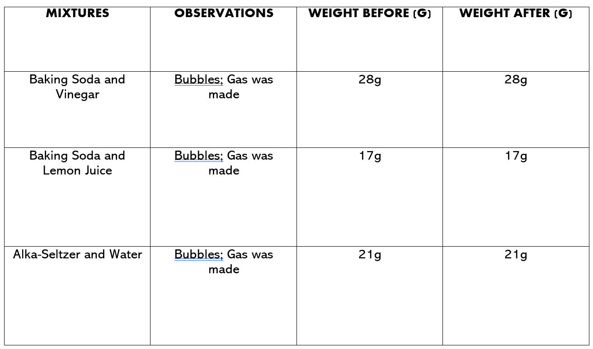

Slide 6
I believe that chemical reactions will create a change to the different substances, but these changes will not change the weight of them. To begin the experiment, I weighed each substance before they were mixed. Next, I weighed the substances after they were mixed. The weight remained the same for each substance even though a chemical reaction occurred and a gas was produced. Based off my evidence, I can say that chemical reactions do not change the weight of different mixtures.

Slide 7
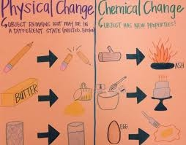
The article told me that even though gas, a new substance was formed, the original weight of the two substances did not change.

Slide 8
https://education.nationalgeographic.org/resource/changes-matter-physical-vs-chemical-changes

